Slide 1

DOCKER 101

Slide 2
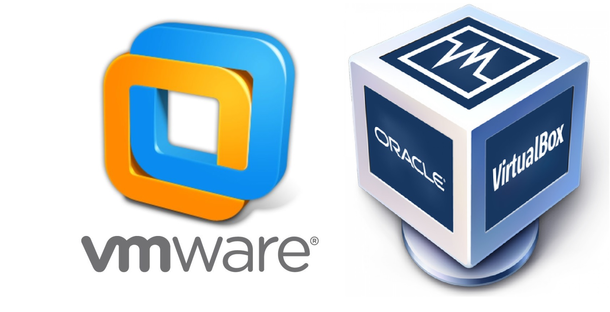
HISTORY
Virtualization: Before containerization, this was the way to isolate, organize applications with their dependencies in its own virtual machine. These VM run multiple applications on the same physical HW.
Drawbacks:
VM were bulky in size
Running multiple VMs lead to unestable performance
Long time boot-up process
VM not solve problems like portability, sw updates, CI/CD
Containerization: These virtualization’s drawbacks led the emergence of this new technique called containerization.

Slide 3

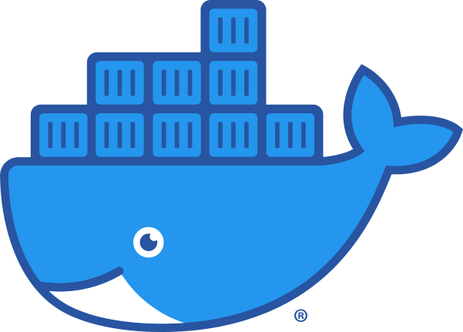
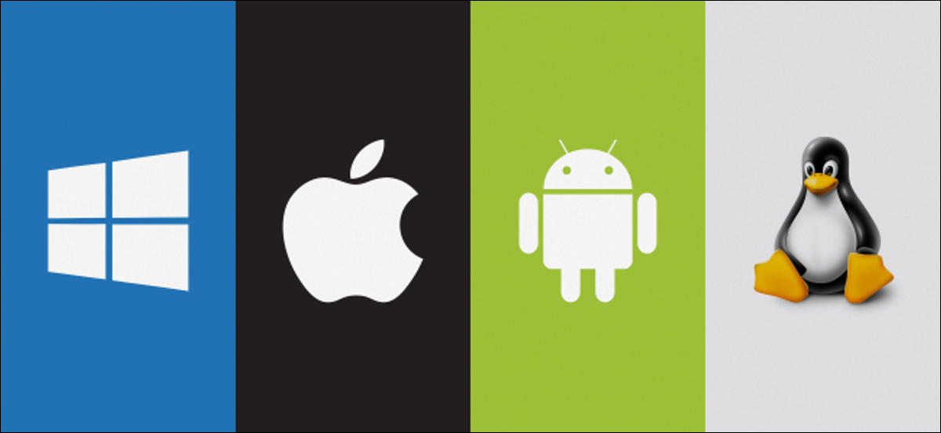
CONTAINERIZATION
Containerization: is a type of virtualization which brings virtualization to the operating system level.
While virtualization brings abstraction to the hardware, containerization brings abstraction to the operating system.
Abstracts from
Abstracts from

Slide 4
Reasons to use containers
Containers have no guest OS and use the host’s operating system. So, they share relevant libraries and resources as and when needed
Processing and execution of applications are very fast since applications specific binaries and libraries of containers run on the host kernel.
Booting up a container takes only a fraction of a second, and also containers are lightweight and faster than Virtual Machines.

Slide 5
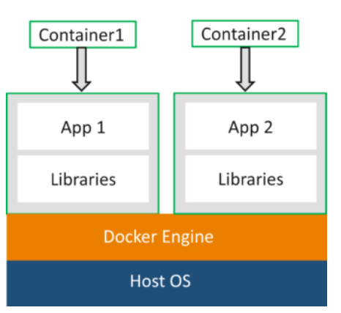
DOCKER EXPLAINED
Docker is a platform that packages an application and all its dependencies together in the form of containers. This containerization aspect of Docker ensures that the application works in any environment.
Each and every application runs on separate containers and has its own set of dependencies and libraries. This ensures that each application is independent of other applications, giving developers reassurance that they can build applications that will not interfere with one another.
So a developer can build a container having different applications installed on it and give it to the QA team. Then the QA team would only need to run the container to replicate the developer’s environment.

Slide 6
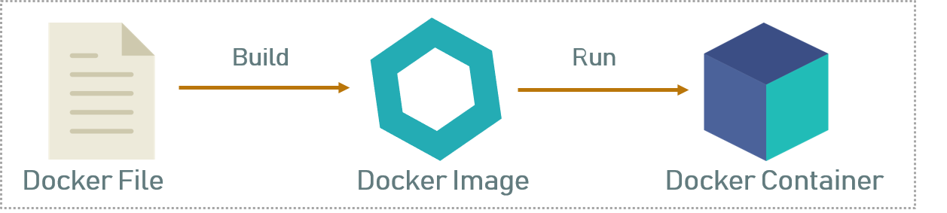
DOCKERfile, images and containers
As you can see in the above diagram when the Dockerfile is built, it becomes a Docker image, and when we run the Docker image then it finally becomes a Docker container.
Dockerfile is a text document that contains all the commands that a user can call on the command line to assemble an image. So, Docker can build images automatically by reading the instructions from a Dockerfile with docker build command.
A Docker image can be compared to a template that is used to create Docker containers. Use docker run to run the image and create a container. Docker images are stored in the Docker Registry. It can be either a user’s local repository or a public repository like a Dockerhub which allows multiple users to collaborate in building an application.
Docker container is a running instance of a Docker image as they hold the entire package needed to run the application. So, these are basically the ready applications created from Docker images.

Slide 7
ANATOMY OF A DOCKER FILE
FROM The FROM instruction initializes a new build stage and sets the Base Image for subsequent instructions. As such, a valid Dockerfile must start with a FROM instruction.
RUN The RUN instruction will execute any commands in a new layer on top of the current image and commit the results. The resulting committed image will be used for the next step in the Dockerfile.
CMD The main purpose of a CMD is to provide defaults for an executing container.
https://docs.docker.com/engine/reference/builder/

